Slide 1
R for the Complete Beginner
Greta Todorova

Slide 2
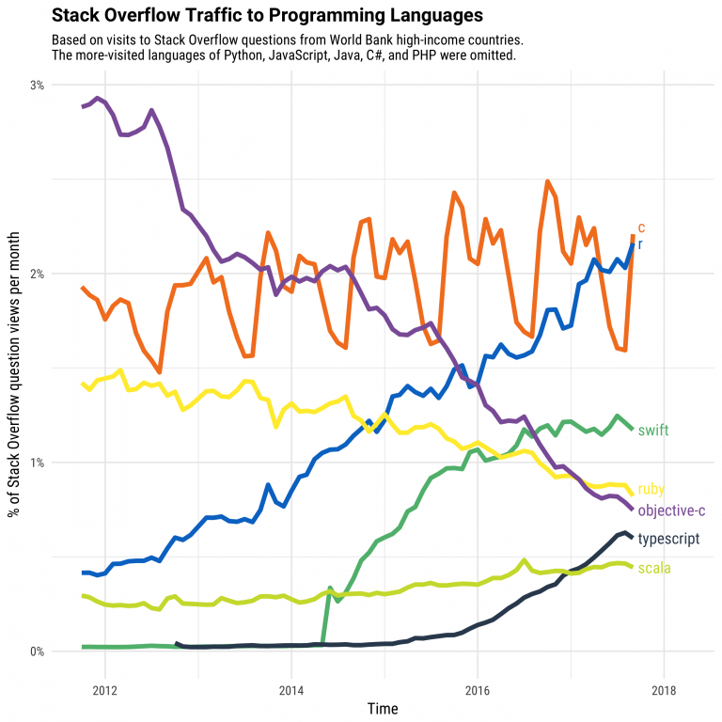
R and RStudio
R is a programming language, based on S
R is growing in popularity and has a large online community
RStudio provides a General User Interface (GUI)
https://stackoverflow.blog/2017/10/10/impressive-growth-r/

Slide 3
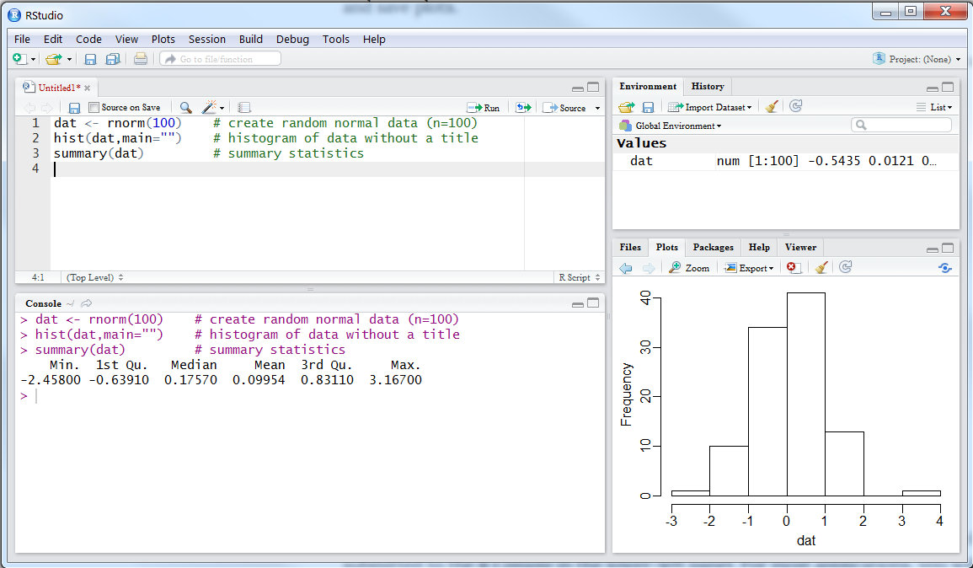
R Studio
Script/Code
Environments
Plots/WD/Help etc,
Console

Slide 4
Scripts vs Console
Scripts | Console
Saves work for the future | Does not save your work
Good for final analysis | Good for testing things out
Can leave comments for the future | Shows you errors and warnings
Can create sections | Output is shown here

Slide 5
Packages
A compilation of functions
Installed only once:
install.packages(“name of package”)
Loaded or called every new session (every time you open R studio)
library(name of package)
Only call the ones you need
Think of a library full of books. We ‘buy’ books by installing the package and put it in our library. Every time we want to read that book, we need to take it out of the library.

Slide 6
Functions
Similar to Excel and SAS
Each function has a name and a set of arguments
Some arguments are necessary, some are optional
read_excel(file_path, sheet, col_names, …)
Name of function necessary argument additional arguments you can skip

Slide 7
Some notes
Step 1. Always set your working directory
Working directory is where your script and data files are located
Recommendation: Keep one folder per project
Load in the libraries you are going to use at the beginning of the script
Comments should describe why you are doing something not only what you are doing
View() the he data once you have done something to it
Name variables with reasonable names. Names must not start with a number.

Slide 8
Lets jump right in

Slide 9
Reading/ loading files
Can work with a variety of file types
We are going to explore 2
csv files: read_csv() package readr
xls, xlsx files: read_excel() package readxl
Provide the name including extension of the file with quotations:
“my_file.csv”

Slide 10
Select variables (i.e. columns) dplyr::select
select(data, variable_names_unquoted)
Use backticks `` for variable names of more than one word
No need to quote variable names
To remove variables can use ‘–’
To remove more than one variable, need to use
c(variable1, variable2)

Slide 11
Keep or remove observations (rows) dplyr::filter
filter(data, variable_to_check == some_condition)
Filters IN i.e. keeps rows that match the condition
equal ==
not equal !=
larger than >
smaller than <

Slide 12
Creating new variables dplyr::mutate
mutate(data, new_variable_name = what_is_in_the_variable, new_variable_name2 = ...)
Create new variables based on a condition, or calculation
Done on a row by row basis

Slide 13
Grouping dplyr:: group_by
group_by(data, variable1, variable2,...)
Creates groups based on the variables given
Does not produce a visible change in the data
Action is kept in the memory of the data

Slide 14
Summarise dplyr::summarise
summarise(data, summary_variable_name = some_function())
Works great with grouped variables
Can use a wide variety of functions to create summaries

Slide 15
From long to wide data format with tidyr
spread(data, key = variable_with_names, value = variabe_with_values, ...)
The rows in the key argument become column names
The values in the value argument get redistributed
All other variables can not have unique variables

Slide 16
From wide to long format with tidyr
gather(data, key = "name_for_var_with_labels", value = 'name_for_var_with_values', c(variable1, variable2,...))
The opposite of spread()
Turns column titles into row entries, which correspond to the values

Slide 17
Lets Plot

Slide 18
ggplot2
Works in layers
Layer 1: data to be used
Layer 2: plot structure
Layer 3 etc: optional
In reality can plot many plots on top of each other

Slide 19
ggplot2
ggplot(data, aes())
This sets the first layer: What the data is.
Then we add geoms_ with + . Each geom_ is a separate layer.
geom_point(): dot plot
geom_col: bar chart
geom_line: line graph

Slide 20
A simple task to cover everything from the beginning
Pick one industry
Create a summary table for export only for international and rest of UK exports
Create a line graph

Slide 21
Resources
R studio cheat sheets will help. I still use them
Google: large community means a lot of questions which have already been answered
Common place for answers:
Stack overflow
http://rprogramming.net/rename-columns-in-r/
various blogs: i.e. Rstudio blog (https://blog.rstudio.com/2014/07/22/introducing-tidyr/)
SG Yammer R users group

